Slide 1


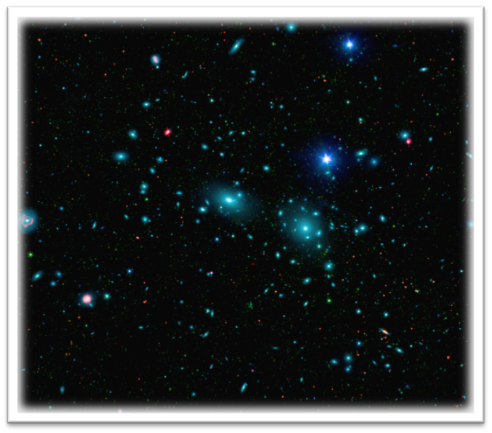
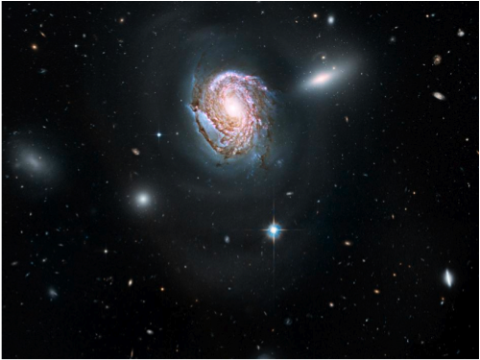
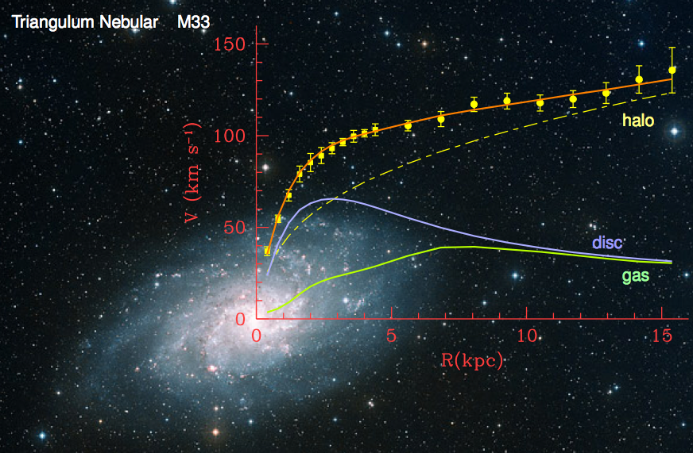
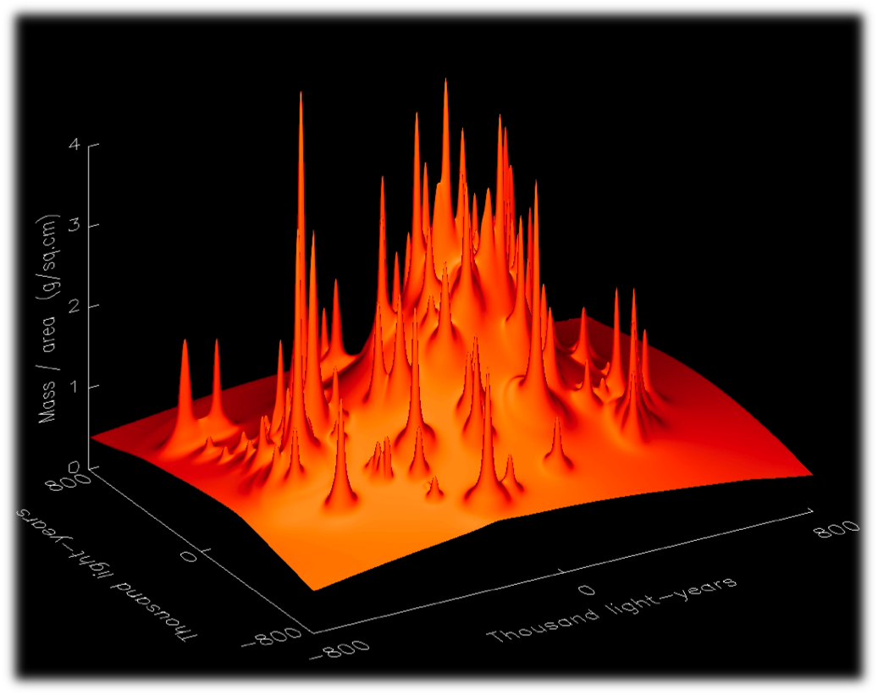
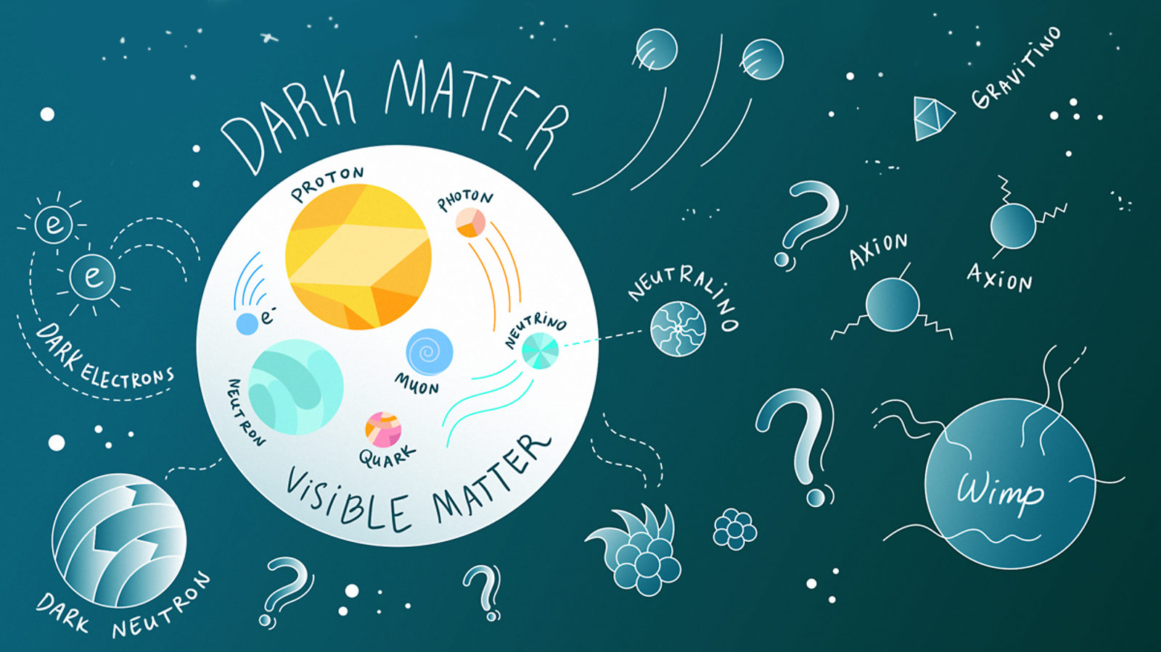
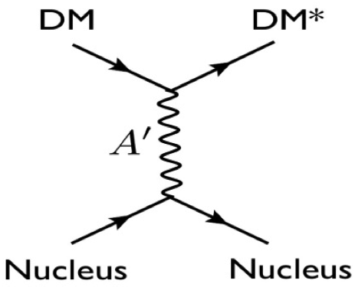
What is Dark Matter?
Thomas Jefferson National Accelerator Facility
First Evidence: Zwicky and the spherical insult
Vera Rubin and ionized clouds
Left: the COMA cluster, containing over 1,000 identified galaxies. One of them is NGC 4911, on the right.
In 1933 Fritz Zwicky was the first to infer the existence of unseen matter. He analyzed over 400 galaxies in the COMA cluster and noticed that they move 50 times faster than the calculations based on their mass. The implications were astonishing: something unknown, and enormous, was accelerating them.
These results were regarded with a healthy amount of skepticism for decades. It didn’t help that Zwicky was quite a character, furious with anyone not agreeing with him. He accused Hubble of being a “sycophant” and was not allowed to use the Mount Palomar telescope until late in his career.
Vera Rubin, left and top right. Bottom right: her 1970 article, which is now regarded as the first smoking gun evidence of dark matter
Vera Rubin in the ’60s and ’70s was measuring the movement of ionized hydrogen clouds in many galaxies around the cosmos.
Naturally we expect that these clouds slow down as their distance from the center of the galaxies increases.
Vera found that not only do the clouds not slow down, but in many cases their speed even increased a little!
Rubin’s work was the first clear, observational evidence for dark matter.
Zwicky coined the word “spherical bastard”. to address people that didn’t agree with him, A spherical bastard is a bastard no matter which way you look at them.
More Evidence: Centrifugal Force and Gravitational Lensing
Did you know?
Clusters of galaxies produce a significant dent in the fabric of space-time: They are powerful optical lenses.
Just like an every-day lens, they enlarge, distort and duplicate images of the same object.
In the top picture the cluster CL 0024 (yellow bright objects) is a powerful lens system (119 lenses in fact) and the same galaxy is seen 5 times.
Computer simulations take into account the total mass of all the lenses, the shape, orientation and mass of the single galaxies to produce a model of the lens, seen in the bottom picture.
The individual peaks are the known galaxies. But wait: there’s a hill where all the lenses sit… and what is that huge mountain in the middle?
Over 2 millions models were tried, and they all come up with the same result: there is something invisible. And that is what we call dark matter.
Dark Matter makes up a quarter of the universe. Without it, galaxies would fall apart, and stars would spin off into space.
Several experiments are searching for dark matter, and some of them may have even already found it. The problem is that no experiment has been able to make that claim with enough confidence to convince the wider scientific community—either due to statistics or an inability to rule out alternative possible explanations.
Dark matter doesn’t interact much with itself or anything else. If it did, it would slow down and clump too much and that wouldn’t be in agreement with the data.
Dark matter is responsible for the structures in the universe: it is responsible for the filaments along which galaxies later form
Dark matter doesn’t interact enough to form objects as dense as planets, but it does have ‘halos’ of varying density that move around in galaxies.
Yellow points: the rotation curve has been measured for over 1,000 galaxies in 2002. The gravitational force of the objects we see (blue and green lines) can account for only 10% of the total needed to describe the experimental data. This shows that dark matter amounts for 90% of the galaxies’ mass.
The Hunt is On at Jefferson Lab Too.
Is dark matter made of dark photons?
Top: the suggested mechanism that Dark Matter interacts with ordinary matter, through a Dark Photon A’ (also called Heavy Photon).
Bottom: how we can “produce” Dark Photons at JLab. We direct the JLab high intensity electron beam into a very dense target (we will use Tungsten). This will maximize our chances of producing dark photons. Those will decay into an electron/positron pair that can be detected in Hall-B with the Heavy Photon Search (HPS) setup.
So what is dark matter? Actually we do not know yet. Scientists have come up with several models for what dark matter might be like. Some think it’s made of WIMPs, Weakly Interacting Massive Particles. Other possibilities include particles conveniently already predicted in models of supersymmetry. Groups of scientists are also searching for dark-matter particles called axions. At Jefferson lab we are looking for Heavy Photons, particles that have properties similar to ordinary light but have mass and are invisible.

